Slide 1
Parent Support Organization Training
Beth Lake
Community & Family Engagement Coordinator
blake@amphi.com
520-696-5211

Slide 2
Parent Support Org Information
LOCATION: under “Families” tab of District website
Lots of Information
Form for Annual Approval/Recognition by Governing Board
Fundraising Approval Form
Informal or Formal Organization
Getting 501c3 status
Sample Bylaws, Goals, Budgets, and more
Format for Financial Reports
Reference Manuals

Slide 3
Annual Application for Governing Board
Application due in August or as soon as it is formed
Approved before you begin any activities/fundraising for the school year
Benefits of District Affiliation:
Coverage Arizona School Risk Retention Trust insurance policy includes liability insurance for parent support organizations as long as their meetings and activities are approved and co-sponsored by the school administrator
Free website page through Amphi
No facilities charge for use on school days/evenings, even for community events sponsored by organization

Slide 4
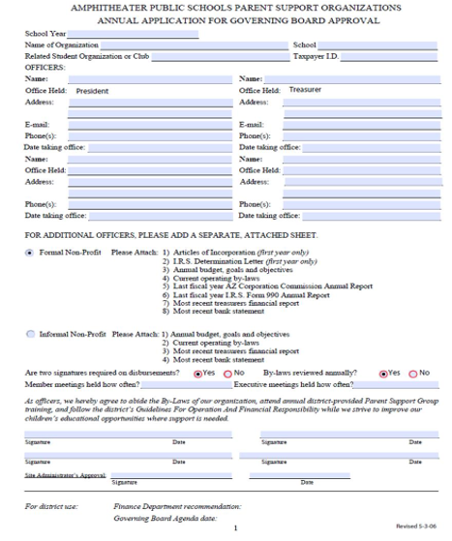
Annual Application
Include officer information
Group must have its own EIN (Taxpayer ID)
Must have documentation based on Informal or Formal Organization
Two signers for checks
Bylaws reviewed annually
Bank statements mailed to school
Turn all documents into your Administration for approval

Slide 5
Informal vs Formal Organization
Informal
Advantages:
Inexpensive
Simple to establish
Disadvantages:
Donations to organizations are not tax deductible
Personal liability can attach to the officers if negligence is established
Officers can be held personally responsible and liable for contractual obligations that they have signed
IRS may determine that annual net revenue of the organization is subject to Federal income tax
Formal (501c3)
Advantages:
Tax deduction for donations to organization
No personal liability for the officers as long as acting as a reasonable, prudent person
Disadvantages:
Expensive and time consuming to establish
Requires diligent annual reporting by succeeding officers with penalties for non-compliance
​
​

Slide 6
Administrative Guidelines
Election of Officers
Any parent/guardian (or adult listed in bylaws) may hold a board position
Staff members of school site may not be on the board
District staff members from other sites may be elected to board. Finance would prefer the Treasurer & President to be a non-staff member.
Officers must complete the required Amphi Annual Form whether a formal or informal non-profit
Your bylaws may allow for co-positions
Verify terms of office in bylaws before election

Slide 7
Meetings
Bylaws should be followed for all procedures and practices, if not specifically covered in bylaws, use Roberts Rules.
Should be scheduled at the beginning of the year on a consistent day of the month if possible
Advertise with email, marquee, website, Peachjar flyer, social media etc.
Include proposed Agenda on website
Any special meetings may be called by the board and advertised at least a week in advance through the accepted communication system. Agenda must be included in advertisement of meeting.
Budgets, bylaw changes and elections require entire membership to have the opportunity to vote and at least 2 weeks notice
Do your bylaws allow for virtual meetings and voting?

Slide 8
Bylaws
Bylaws should be reviewed annually at either the beginning or end of the year
Any proposed changes require a following meeting to approve
To propose a change in the bylaws:
Advertise the intention to change the bylaws
List the proposed changes in the meeting communication
At the first meeting, discuss the proposed changes, distribute copies of original bylaws and proposed changes
Advertise the proposed change in bylaws and any discussion covered at meeting
At second meeting, ask for approval to amend bylaws
Publish bylaws in parent communication, website, etc. and send copy of changes to Amphi Finance (and IRS if formal non-profit)

Slide 9
Advisor/Coach/Administrator
May not sit on the board ​
May not control communication for organization​
May not call for meetings (exception made for first meeting of the year/season)​
Should not email parents for organization communication​
May be consulted about budgets, expenditures, fundraisers, etc.
May be invited to Executive board meetings with the ​officers at the discretion of the board.
May not dictate to the board about who may elected to the board, policies/practices listed in the bylaws
May not be responsible for organization funds, nor may the advisor supersede board bylaws or IRS regulations ​
Should an they need to prevent a parent or guardian from attending meetings or board position, this should be handled in private between the board and the coach/advisor/admin with the coach/advisor/admin discussing situation with parent(s) in question.​

Slide 10
Financial Guidelines
Produce monthly ﬁnancial report and distribute to the members and Principal
Expenses must be in accordance with bylaws
Expenses must be voted on by members with deﬁned purpose and set budget or limit
2 signatures are recommended on checks​
Bank statements must be mailed to the school, not home addresses of board members​
Capital items (over $1000.00) purchased by the support group for the School/District are considered a gift to the District and must be approved by the Governing Board. Gift & Donation forms are available in the Resource Library.

Slide 11
Compensating a District Employee
Per Governing Board regulation KBE-EA:
Please contact Scott Little, CFO, if you have additional questions. slittle@amphi.com

Slide 12
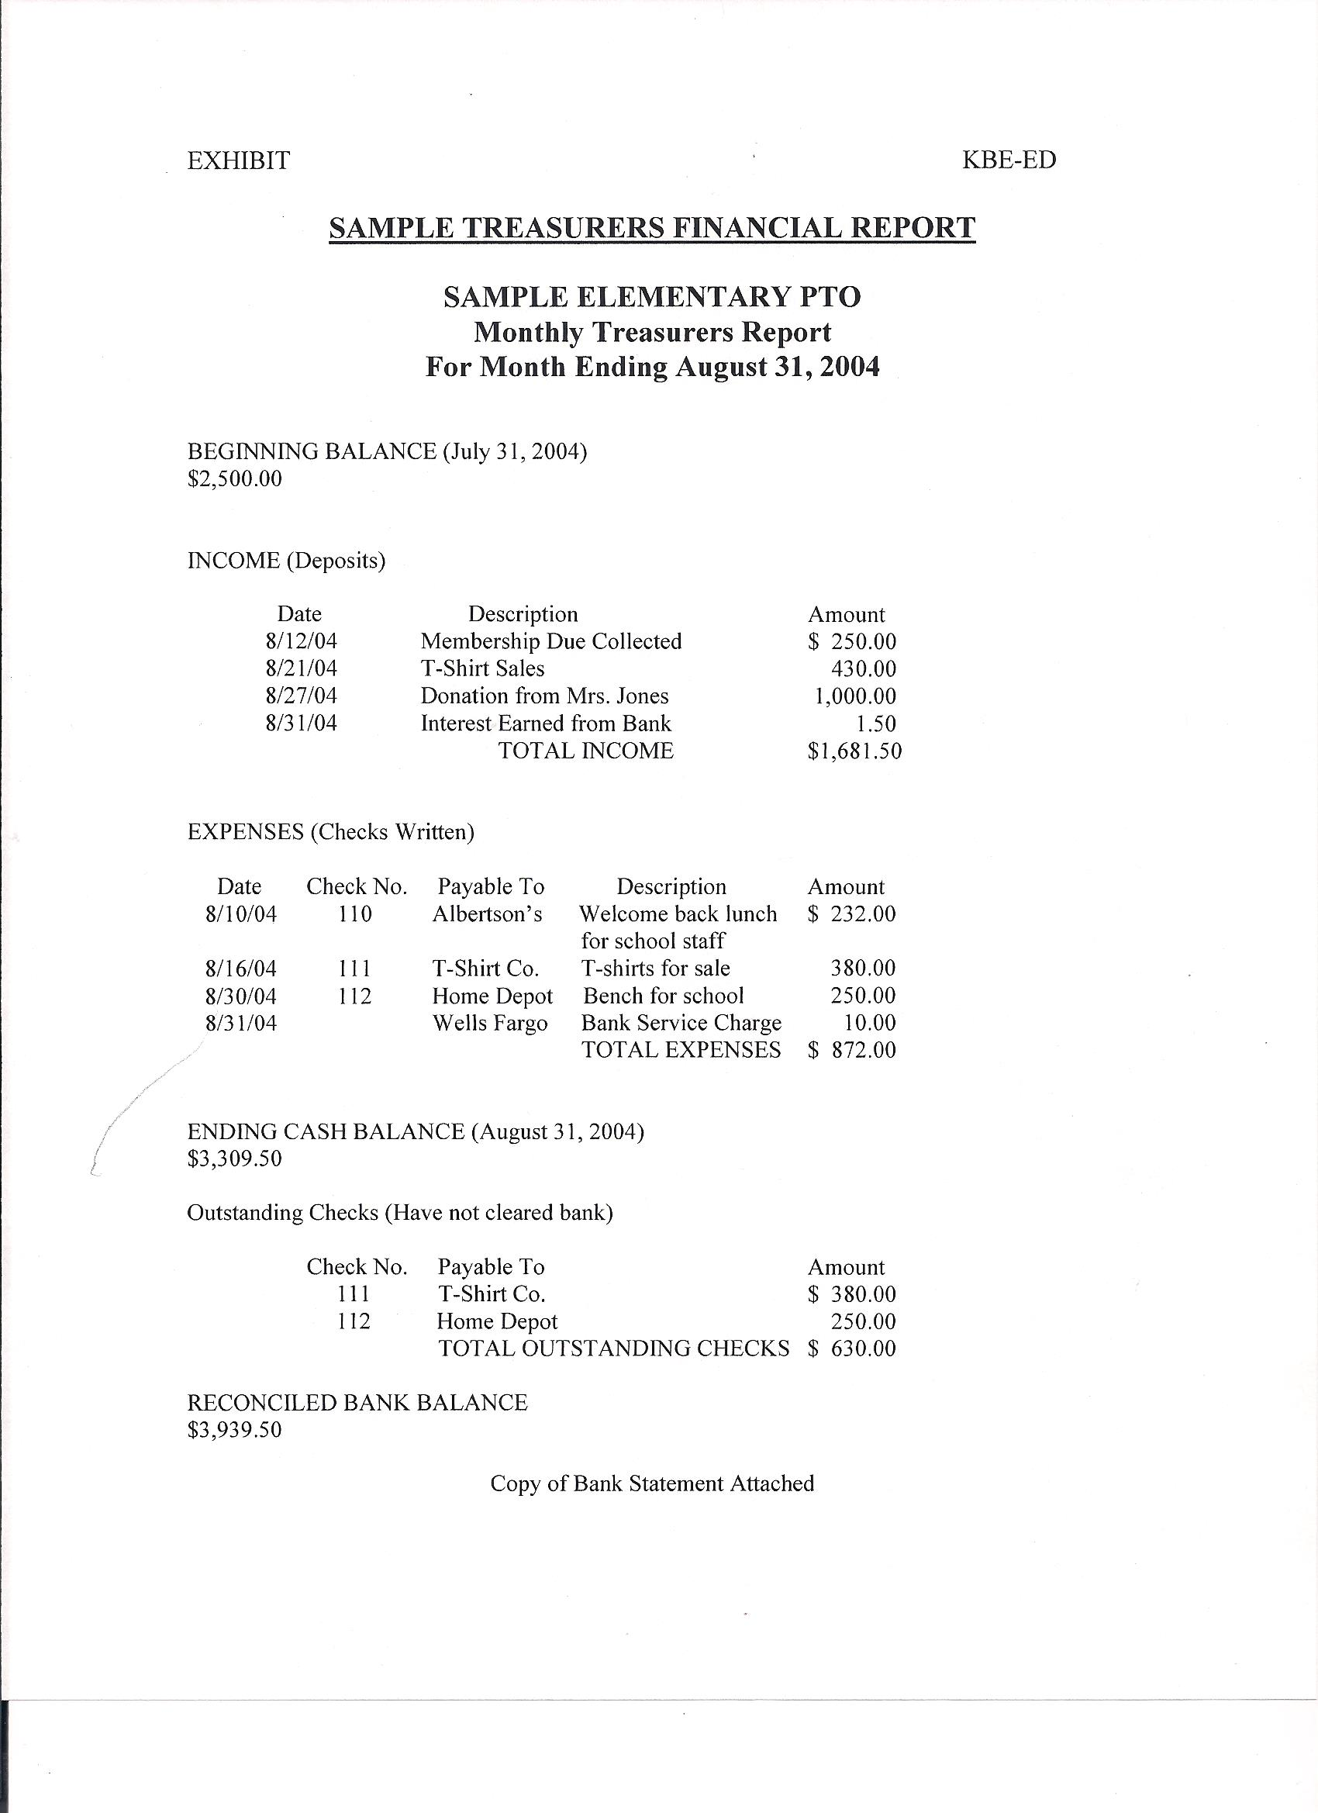
Sample Monthly Financial Report
Identify all revenue
sources
Use final month’s report or
cumulative budget for prior year as required report for application
Itemize all expenses
Cash balance should
match bank statement
Copies of report made available to anyone
Vote to approve treasurer’s report and note in minutes, post on webpage

Slide 13
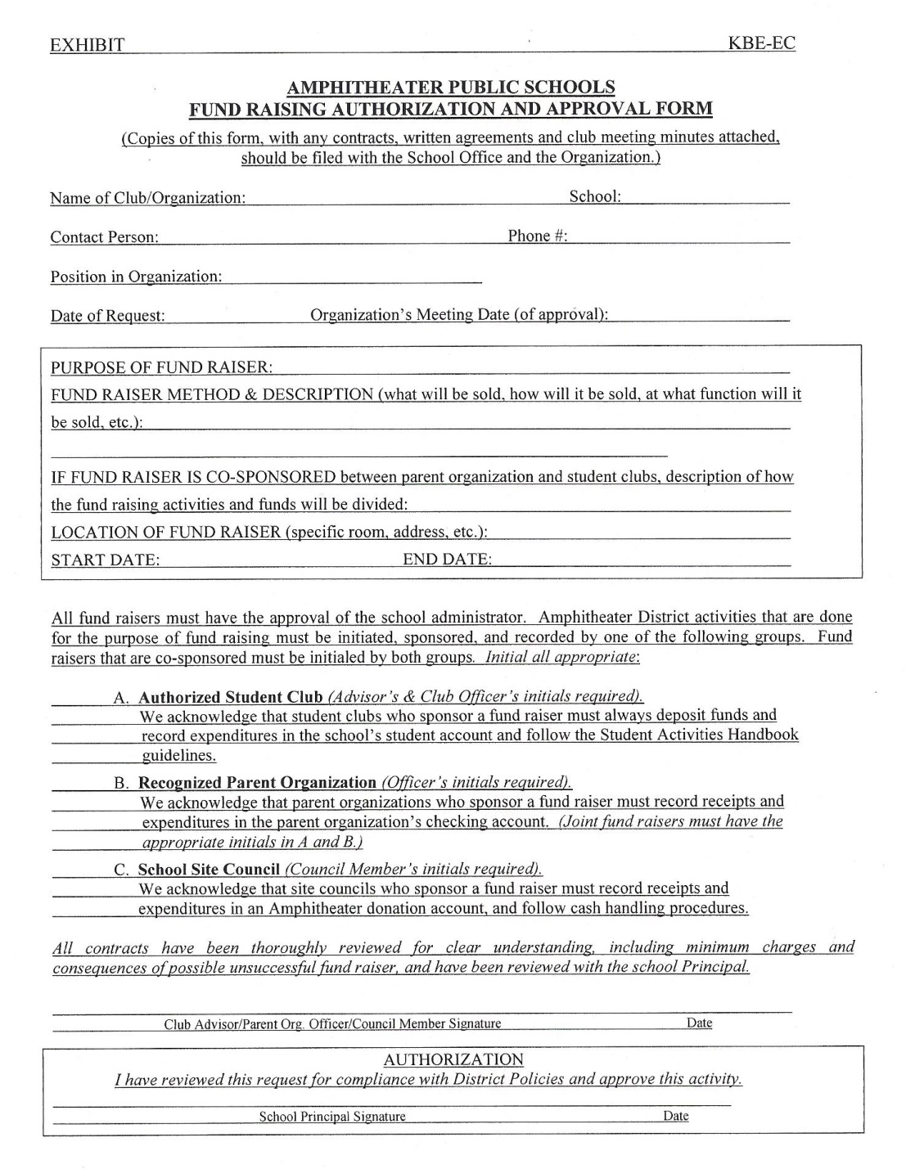
Required Fundraising Form
Available on the website. Submit at least 2 weeks before fundraiser.
Fundraisers must be approved by the school administration, with designated uses and distributions specified for each fundraiser
Keep copy of document with Principal signature to ensure you are covered by insurance
Monies raised are to be deposited in the account by the organization
Funds shall not be refunded to an individual who leaves or is dismissed from the program

Slide 14
Conflict of Interest
Board members should make sure that the organization's income is not being used for the personal benefit of individuals connected to the organization.
There must be full disclosure of the board member's interest, and the terms of the "deal" must be fair to the nonprofit.
The board member to disclose the conflict and refrain from discussing or voting on the matter.
Look to the PSO Handbook and webpage for more information and a sample Conflict of Interest agreement.​

Slide 15
Joint Fundraising with Student Group
Occurs in Middle or High Schools
You must split profits
Split set before event takes place
Estimate relative effort going into event
Students’ funds go to the bookstore or school for credit to group’s Student Activities Account
District only holds the funds for use by the group

Slide 16
Event Planning
Determine purpose and type of event​
Fun​
Fundraising​
Community relations​
School spirit​
End of season/recognition​
Find volunteers to plan event​
You need a committee to divide and conquer​
Check with school, district, community calendars​
Complete all required fundraising/facility forms​
Once event/fundraiser is approved, get the word out​​
Recruit volunteers far in advance​
High School volunteer clubs​
Parents​
Middle School students

Slide 17
Fundraising Ideas
Direct Giving
Sell spirit wear​
Have students sell items​
Cookie dough​
Magazines​
Flowers​
Candy​
Restaurant cards​
Discount cards/book​
​
​Festivals/Carnivals
Special Events​
Coin drives​
Walk a thon​
Donation requests for a specific purpose​
Restaurant nights
Book fairs for K-8
Banners

Slide 18
Raffles
Formal Non-profit for at least 5 years may hold ​a raffle
On or off campus – adult to adult​
Not sold by students​
Informal Non-Profit may NOT hold a raffle​​
May use ​
Incentive programs​
Door Prizes​
Silent Auctions​
A different 501(3)c organization​
​

Slide 19
Make more money
Advertise your fundraisers outside of your parent group​
Encourage families/students to take ownership of the fundraiser​
Offer incentives for student participation​
Double check dates of events for community conflicts​
Recruit volunteers early​
Find connections on campus and in the community​
Get your event/fundraiser information out there​
Marquee​
Student announcements​
Campus event announcements​
Parent Organization emails​
Peachjar

Slide 20
Volunteer Recruitment
Recruit and retain volunteers​​
Help volunteers to find a niche that shares their skill​s
Welcome feedback and different approaches​
Volunteer signup online, at school events, etc.​
Groom volunteers for bigger positions​
Look for volunteer pairs to share the duty​
Don’t overwhelm or ignore potential volunteers​
Be very clear about expectations ​
What are their duties​
Budget and guidelines for their duties​
Which board member over sees the volunteers?​

Slide 21
Communication
Work with school and district staff, parents and the community to share what is happening.
Principal's Newsletter
Weekly parent email
Website
Social media
Marquee
Posters on Campus and in Office
Peachjar
Encourage stakeholders to share information
Events on campus
Teacher/Club newsletters and social media
Community student opportunities
Sports
Scouts
Clubs
This Photo by Unknown author is licensed under CC BY-NC.

Slide 22
Get to know your parents and staff
Create surveys
What do parents/staff want from Organization
What skills/gifts do parents/staff have to help you?
Where do parents work?
Does their employer match donations? Provide volunteers?
What is needed for staff? Classrooms? Activities? Etc.
Communicate with staff & parents
Share the needs of your organization
Ask for help
Ask staff to share your info in their emails/newsletters
Use campus clubs to share your info
Share resources and ask for help from other organizations
Network with your feeder pattern and other organizations on your campus
Check out the Parent Support Organization webpage for more help
Contact Beth Lake if you need help or have a question

Slide 23
Questions?

Slide 24
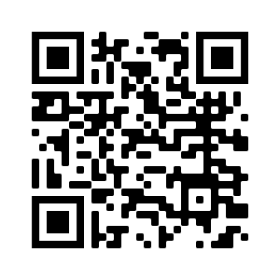
Beth Lake, Community & Family Engagement blake@amphi.com 520-696-5211
Scan here and bookmark the webpage
Sample forms
Resource manuals

